Slide 1

University of Chittagong
Java Basic Programs
Dr. Abu Nowshed Chy
Department of Computer Science and Engineering
Faculty Profile

Slide 2
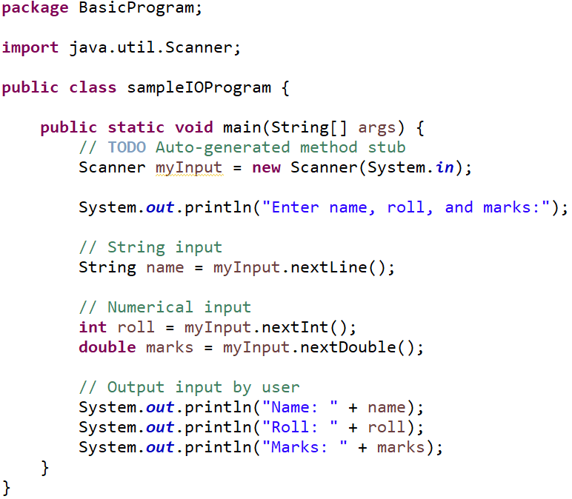
Sample Program
‹#›

Slide 3
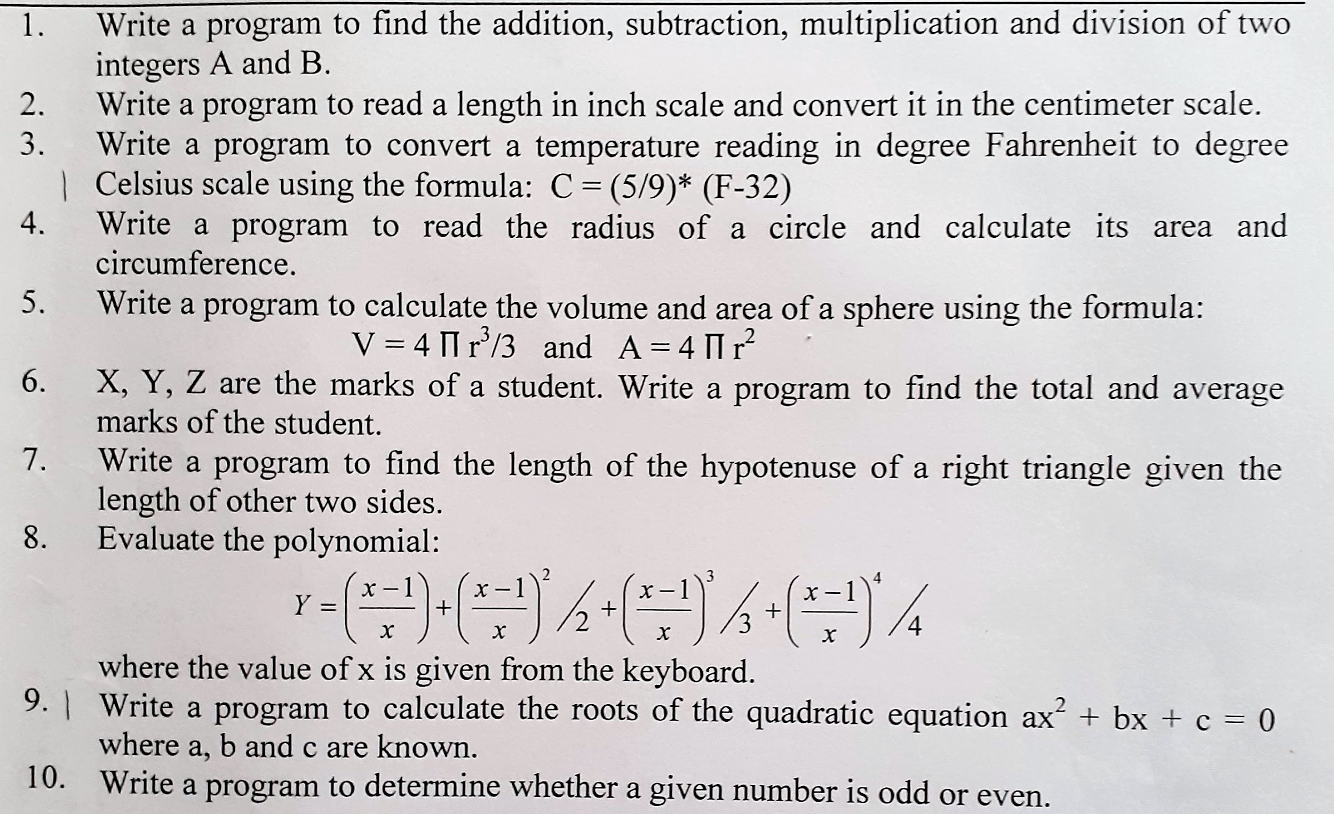
Practice Programs
‹#›

Slide 4
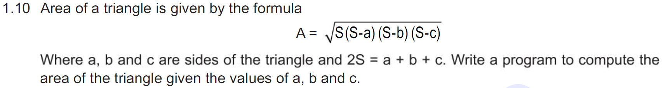
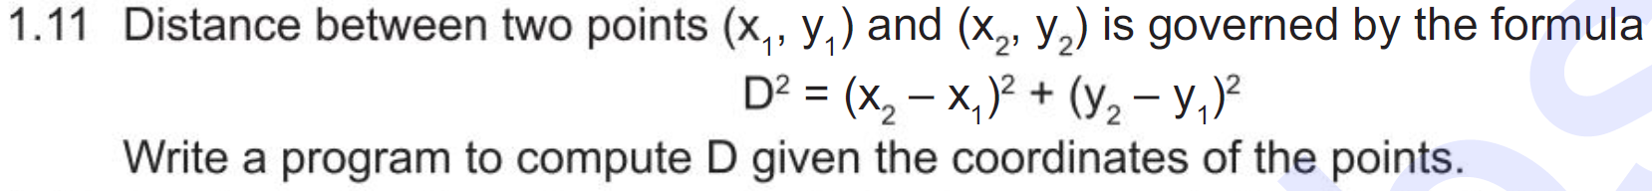
Practice Programs
‹#›

Slide 5
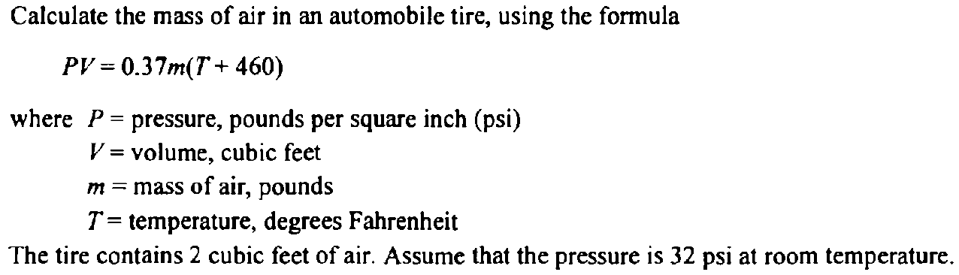
Practice Programs
‹#›

Slide 6

‹#›

